Slide 1
Cascading Style Sheets III
CSS3 & HTML5

Slide 2
Some CSS3 Features

Slide 3


CSS3 Rounded Corners

Slide 4


CSS3 Box Shadow

Slide 5


CSS3 Background-Size

Slide 6


CSS3 Multiple Background Images

Slide 7
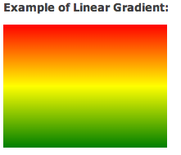
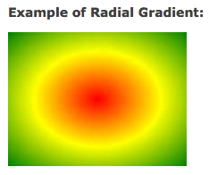
CSS3 Gradients
2 types of gradients
  Linear gradients
  Radial gradients

Slide 8


CSS3 Linear Gradient
To create a gradient, you need to define at least 2 colors:

Slide 9
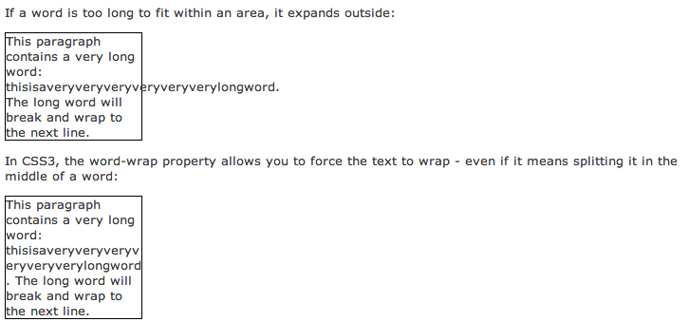
CSS3 Word Wrap

Slide 10


CSS3 Text Shadow
Horizontal shadow, vertical shadow, blur distance

Slide 11
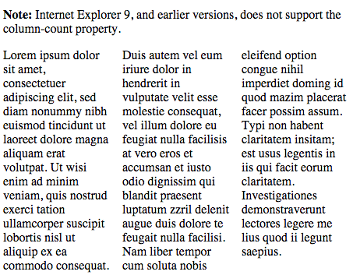

CSS3 Multiple Columns
Specifies the number of columns an element should be divided into

Slide 12

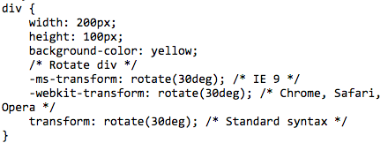
CSS3 2D Transforms
Elements can be moved, scaled, turned, spinned, stretched …

Slide 13
What else is CSS3 capable of?
3D Transforms
Transitions
Animations
…….

Slide 14
HTML5 Structural Elements

Slide 15
Header Element
<header>…</header>
  Contains headings of either a webpage or an area of the document
  Typically contains heading level elements (h1 … h6)

Slide 16
Hgroup Element
<hgroup>…</hgroup>
  Groups heading level tags and is useful if the logo of a web page contains both the website name and a tagline.

Slide 17
Nav Element
<nav>…</nav>
  Contains a section of navigation hyperlinks

Slide 18
Footer Element
<footer>…</footer>
  Contains the footer content of a web page, article, paragraph …

Slide 19
Section Element
<section>…</section>
  Contains a “section” of a document, such as a chapter or topic.

Slide 20
Article Element
<article>…</article>
  Contains an independent entry, such as a blog posting, comment … that could stand on its own.

Slide 21
Time Element
<time>…</time>
  Represents a date or a time and could be useful to date articles or blog postings.

Slide 22
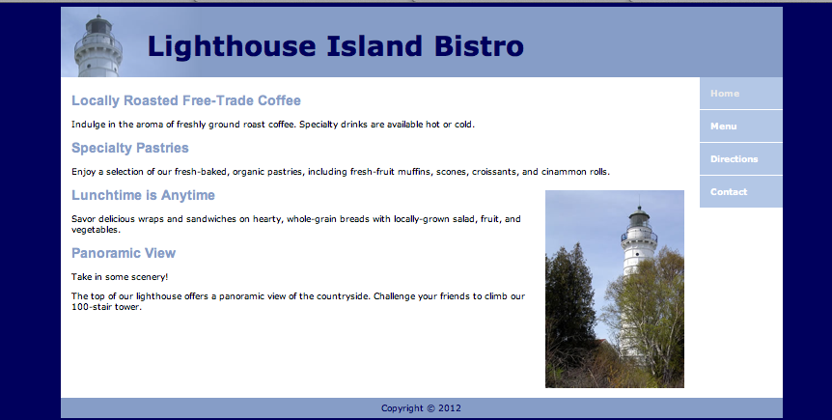
The code for this website is up on Webcourses

Slide 23
Reference
Terry Felke-Morris (2013), Web Development and Design Foundations with HTML
Steven M. Schafer (2005), HTML, CSS, JavaScript, Perl, and PHP Programmer's Reference, Hungry Minds Inc,U.S.
Dan Cederholm (2005), Bulletproof Web Design: Improving Flexibility and Protecting Against Worst-Case Scenarios with XHTML and CSS, New Riders.
Ibrahim Zeid (2004), Mastering the Internet, XHTML, and Javascript

